Slide 1
Subject Review, Questions, and Exam Practice

Slide 2
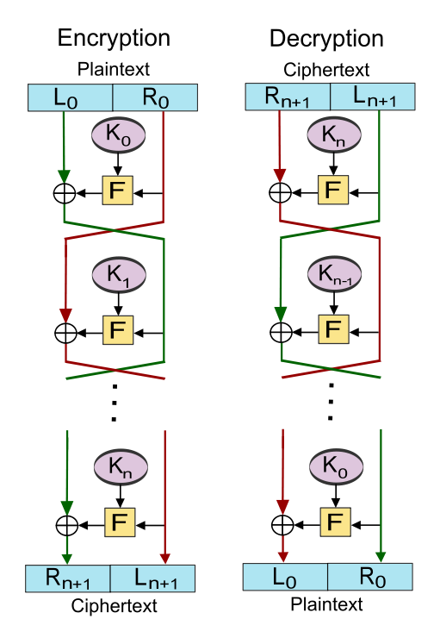
Review : Feistel schemes
Structure used in block cipher construction
Some properties:
Exercise 1: What is the rele-vant security notion?
Exercise 2: What is the connec-tion between security and PRPs?
Exercise 3: Show that 1 round is insecure
Exercise 4: Show that 2 rounds are insecure
Exercise 5: Show that 3 rounds are insecure under IND-CCA

Slide 3
PRPs
Exercise 6: Explain what is meant by the information in the red box

Slide 4
Modes of operation
Exercise 7: Describe the following modes of operation for block ciphers:
ECB
CBC
CTR
Exercise 8: Which modes are deterministic? In which conditions? (think of the IVs)
Exercise 9: Can you find an attack for the ECB mode?

Slide 5
Birthday Paradox
Exercise 10: Explain the result in Experiment 2

Slide 6
Birthday attack vs paradox
Exercise 11: How can we use the birthday paradox in an attack?

Slide 7
Hash functions
Exercise 12: What is the difference between hash functions in general and cryptographic hash functions?
Exercise 13: There are always collisions in hash functions. When do we call a cryptographic hash function secure? Why do we call them secure if such collisions exist?
Exercise 14: Can you give an example of where a stream cipher is used in practical protocols?

Slide 8
Thanks!

