Slide 1
Distance-Bounding and its Applications
Relay attacks, distance-bounding, mafiosi & terrorists

Slide 2
User Authentication
User Name
Anonymous
Password
*******
Logging in to your computer
  Account is associated with particular privileges
  Think admin vs. user
Logging in to web account
  Usually occurs within https://
  Usually allows a user to order “on his account”
Not going to talk much about it here

Slide 3
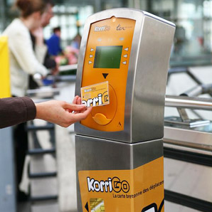
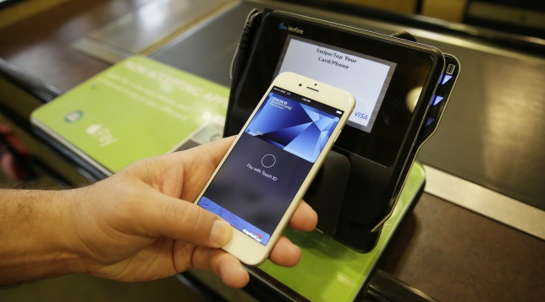
Secure Authentication
Public transport
  KorriGo/NaviGo
  Dutch OV card
Personal identification
  Passports/ID cards
  Employee badge
Contactless payments
Car locking mechanisms
  KeeLoq
  PKES
Very relevant to this talk

Slide 4
RFID/NFC Authentication
Radio Frequency Identification: RFID
  Provers: Smart cards with RFID chip and antenna
    Mostly passive: do not have batteries or own power
    Antenna receives radio waves
    Chip processes messages and answers automatically
  Verifiers: RFID readers
    Active: have power of their own
    Card activation: reader generates electromagnetic fields
    Transmission over radio waves
  RFID are resource constrained: little processing possible

Slide 5
Part I: Basic Authentication

Slide 6
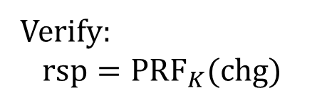
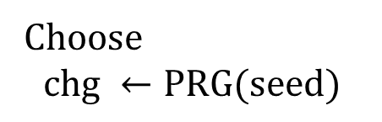





Secure Symmetric-key Authentication
Alice wants to authenticate to Bob, with whom she shares a secret key
$$K$$
Alice
Bob
$$seed$$
Choose
$$chg ←PRG(seed)$$
$$chg$$
$$rsp ←{PRF}_{K}(chg)$$
$$rsp$$
Verify:
$$rsp={PRF}_{K}(chg)$$

Slide 7


Security in Authentication
$$K$$
Alice
Bob
Authentication
Correctness:
  Alice must always authenticate
Security:
  Nobody but Alice should authenticate

Slide 8



Trivial Attacks: Relay
$$K$$
Alice
Bob
$$K$$
chg
$$seed$$
chg
rsp
rsp
Relay attacks bypass any kind of cryptography: encryp-tion, hashing, signatures, etc.
Countermeasure: distance bounding

Slide 9
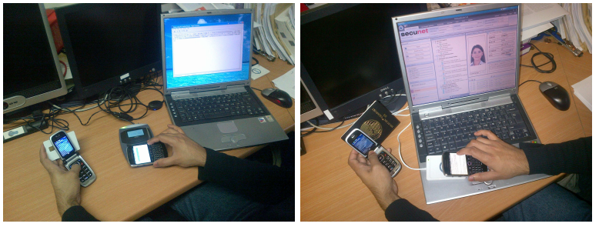
Relay Attacks in Practice
Reader
Reader – different types, each with different specifications
  Most readers (like Touch-a-tag) equipped to deal with cards that follow a specific standard (ISO 14443)

Slide 10
Relay Attacks in Practice
Prover
Prover – different types, usually ISO 14443 compliant
  Identity card, passport
  Public transport card, access card (to a building), car lock keys
  Contactless payment cards

Slide 11
Relay Attacks in Practice
Leech
Attacker which poses as reader to the prover, forwarding information to prover and waiting for it to answer
  Remember: provers answer automatically, without consent

Slide 12
Relay Attacks in Practice
Ghost
Attacker which poses as prover: main attacker which succeeds to authenticate

Slide 13
Not Without Delays
Attacker has to process and forward information
This introduces delays
Off-the-shelf relay tools (e.g. Micropross tools)
  Attacks introduce between 20 and 50 ms
  Most protocol exchanges take up to 2-3 ms
  Even rudimentary distance-bounding detects relays
“Home-made” tools
  Hancke : 12 microseconds
  Thévenon: 2 microseconds
  Francillon et al. : some hundred nanoseconds

Slide 14
Consequences
PKES:
  Prover = token, to be held in your pocket
  Verifier = the car itself
  Authentication: if prover is close, car unlocks, then starts
  Attack: someone else gets your car and drives away
Contactless payments:
  Prover = payment card
  Verifier = contactless card reader
  Authentication: you authenticate, you agree to pay
  Attack: someone makes you pay for what they got
Passport fraud, public transport fraud, etc…

Slide 15
Part II
Clocks and Distance Bounding

Slide 16
Essence of Relay Attack
Alice
Bob
chg
chg
rsp
rsp
In this attack, Alice is the source of the responses
Alice is far away from the verifier (Bob)
Idea: what if we knew how far the response originated?!

Slide 17
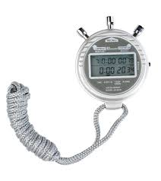

Idea of Distance bounding
Alice
Bob
chg
Start clock
chg
rsp
rsp
Stop clock
Store: $∆T$
Give Bob a clock
Bob measures roundtrip times (RTT) of $chg/rsp$ rounds

Slide 18


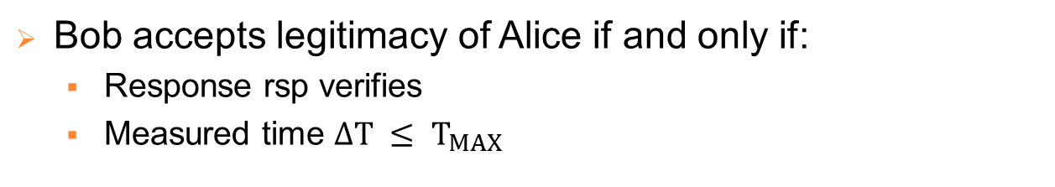
Proximity Bound
Alice
Bob
chg
Start clock
rsp
Stop clock
Store: $∆T$
$$T_{MAX}$$
Proximity bound : time $T_{MAX}$ equivalent to short distance
Bob accepts legitimacy of Alice if and only if:
  Response rsp verifies
  Measured time $∆T ≤ T_{MAX}$

Slide 19



Detecting Relay Attacks
Alice
Bob
chg
Start clock
chg
rsp
rsp
Stop clock
Store: $∆T$
$$T_{MAX}$$
Bob accepts legitimacy of Alice if and only if:
  Response rsp verifies
  Measured time $∆T ≤ T_{MAX}$

Slide 20
Typical Proximity Bound
Contactless payment cards:
  A few centimeters: 2-5cm
Access control cards:
  A few tens of centimeters: 10-20 cm
Logistics:
  Many tens of centimeters

Slide 21
Distance-Bounding Protocols
round
slow
fast
Alice
Bob
………………

Slide 22
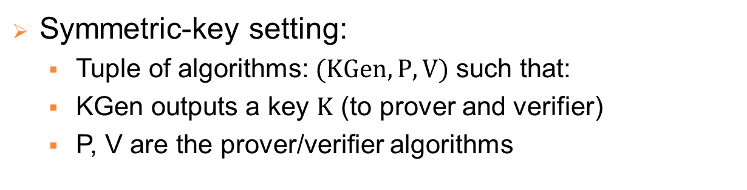
“Secure” Distance Bounding
Two parties:
  Prover (Alice) : wants to prove her legitimacy
  Verifier (Bob) : verifies Alice’s legitimacy
Symmetric-key setting:
  Tuple of algorithms: $(KGen, P, V)$ such that:
  KGen outputs a key $K$ (to prover and verifier)
  P, V are the prover/verifier algorithms
Public-key setting:
  KGen outputs secret/public key-pairs to P and V

Slide 23

Security Properties
P
A
V
$$T_{MAX}$$
Mafia-fraud resistance:
  Attacker A: wants to authenticate to V
  Can use P, but we assume clock detects fast round relays
  Neither P, nor V is aware of attack

Slide 24
Security Properties
P
A
V
$$T_{MAX}$$
Terrorist-fraud resistance:
  Attacker A is now friends with prover P
  They both want A to be able to authenticate
  Assume: P not willing to allow A to then authenticate alone
  P could want A to park in their spot, or open their office

Slide 25
Security Properties
P
V
$$T_{MAX}$$
Distance-fraud resistance:
  Attacker is in fact a legitimate prover P, outside proximity
  He wants to authenticate from outside proximity
  P could want to prove he was at work when he was sick

Slide 26
Security Properties
P
V
$$T_{MAX}$$
P’
Distance hijacking resistance:
  Attacker is in fact a legitimate prover P, outside proximity
  He can use legitimate, honest P’ within proximity for attack
  P’s intentions are the same as for distance-fraud

Slide 27


The Good, The Bad, The Ugly
Attack \ Party | Prover | Verifier | MIM
Mafia Fraud
Terrorist Fraud
Distance Fraud
Dist. Hijacking

Slide 28
Part 2
Distance-Bounding Protocols

Slide 29






What goes into $∆T$?
P
V
$$K$$
$$K$$
$$seed$$
chg
Start clock
rsp
Stop clock
Store: $∆T$
$$T_{MAX}$$
Ideally:
  Transmission time of chg +
  Transmission time of rsp
  Total: 2 x transmission times = 2 x time separating Alice/Bob

Slide 30
What goes into $∆T$?
P
V
$$K$$
$$K$$
$$seed$$
chg
Start clock
rsp
Stop clock
Store: $∆T$
$$T_{MAX}$$
In fact:
  Bob: transmission time of chg
  Alice: processing time (to output rsp)
  Alice: transmission time
Total : 2 x transmission times + processing

Slide 31

Requirements for $∆T$
Constancy of transmission times
… despite changing conditions/environment
Constancy of processing times per round
… despite challenge value
… despite response value
… across different sessions
Constancy of processing times per device
… despite manufacturer/model/chip type

Slide 32
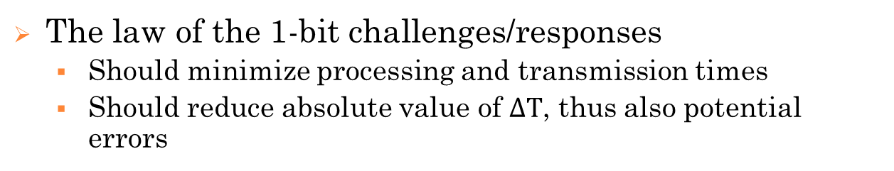
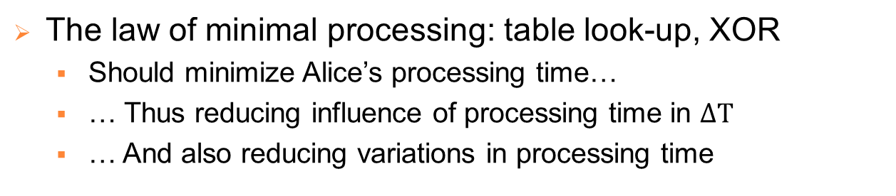
Some Design Principles
The law of the 1-bit challenges/responses
  Should minimize processing and transmission times
  Should reduce absolute value of $∆T$, thus also potential errors
The law of minimal processing: table look-up, XOR
  Should minimize Alice’s processing time…
  … Thus reducing influence of processing time in $∆T$
  … And also reducing variations in processing time
Error handling
  Allows for possible errors or delays in transmissions

Slide 33


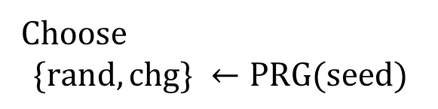
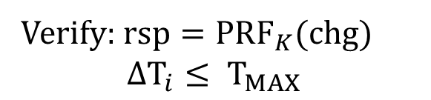








A first Attempt
$$K$$
P
V
$$seed$$
$$K$$
Choose
$$\{rand, chg\} ←PRG(seed)$$
$$rand$$
$$rsp ←{PRF}_{K}(rand)$$
$$rsp$$
Store rsp
For $i=1, …, N$ do:
$${chg}_{i}$$
Store $∆T_{i}$
$${chg}_{i}$$
Verify: $rsp={PRF}_{K}(chg)$
$∆T_{i}≤ T_{MAX}$

Slide 34


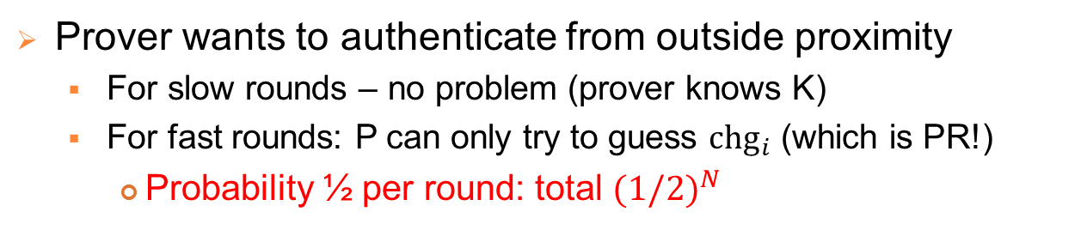



Security: Distance-Fraud Resistance
P
$$rand$$
V
P
$$rsp$$
V
$chg ←PRG(seed)$
$${chg}_{i}$$
$${chg}_{i}$$
Prover wants to authenticate from outside proximity
  For slow rounds – no problem (prover knows K)
  For fast rounds: P can only try to guess ${chg}_{i}$ (which is PR!)
    Probability ½ per round: total ${(1/2)}^{N}$
The law of the 1-bit challenges: ${(1/2)}^{N}$ is optimal!

Slide 35
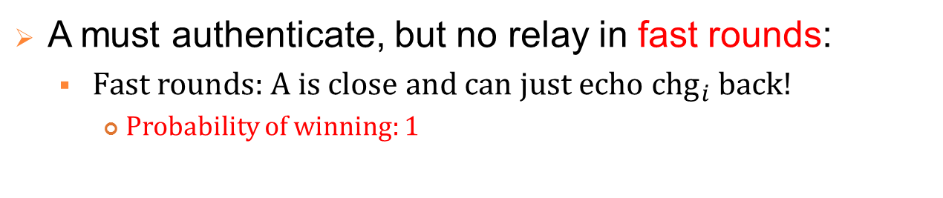
Security: Mafia-Fraud Resistance
P
$$rand$$
V
P
$$rsp$$
A
V
$chg ←PRG(seed)$
$${chg}_{i}$$
$${chg}_{i}$$
A must authenticate, but no relay in fast rounds:
  Fast rounds: A is close and can just echo ${chg}_{i}$ back!
    Probability of winning: 1
The law of the 1-bit challenges/responses: ${(1/2)}^{N}$ is optimal!

Slide 36
Security: Mafia-Fraud Resistance
P
$$rand$$
V
P
$$rsp$$
A
V
$chg ←PRG(seed)$
$${chg}_{i}$$
$${chg}_{i}$$
Conclusion: need to make responses depend on secret key!

Slide 37


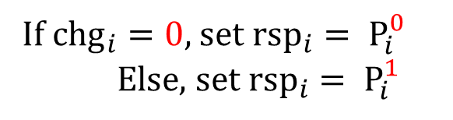
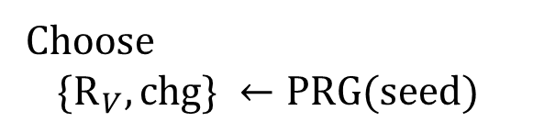
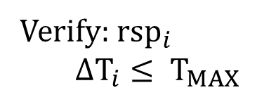






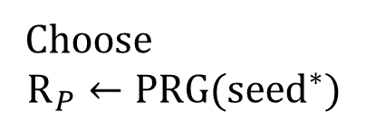




The Hancke & Kuhn Protocol
$$K$$
$${seed}^{∗}$$
P
V
$$seed$$
$$K$$
Choose
$$\{R_{V}, chg\} ←PRG(seed)$$
Choose
$$R_{P}←PRG({seed}^{∗})$$
$$R_{V}$$
$$R_{P}$$
$$P^{0}|P^{1}←{PRF}_{K}\left(R_{P} \right|{ R}_{V})$$
$$P^{0}|P^{1}←{PRF}_{K}\left(R_{P} \right|{ R}_{V})$$
For $i=1, …, N$ do:
$${chg}_{i}$$
If ${chg}_{i}=0$, set ${rsp}_{i}= P_{i}^{0}$
Else, set ${rsp}_{i}= P_{i}^{1}$
Store $∆T_{i}$
$${rsp}_{i}$$
Verify: ${rsp}_{i}$
$∆T_{i}≤ T_{MAX}$

Slide 38
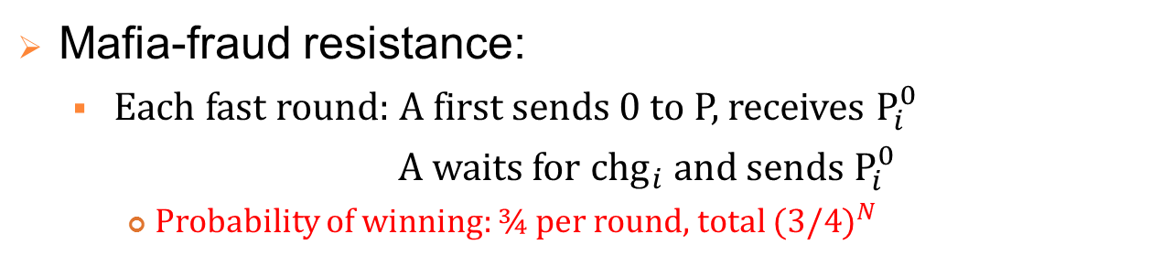






Security: Mafia-Fraud Resistance
P
V
P
$$R_{V}$$
$$R_{P}$$
A
V
$$P^{0}|P^{1}←{PRF}_{K}\left(R_{P} \right|{ R}_{V})$$
$chg ←PRG(seed)$
$${chg}_{i}$$
$$P_{i}^{{chg}_{i}}$$
Mafia-fraud resistance:
  Each fast round: A first sends 0 to P, receives $P_{i}^{0}$
  A waits for ${chg}_{i}$ and sends $P_{i}^{0}$
    Probability of winning: ¾ per round, total ${(3/4)}^{N}$

Slide 39

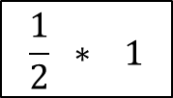




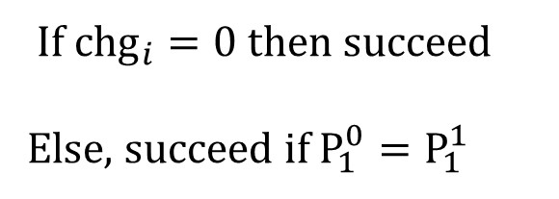


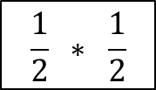
Security: Mafia-Fraud Resistance
P
V
P
$$R_{V}$$
$$R_{P}$$
A
V
$$P^{0}|P^{1}←{PRF}_{K}\left(R_{P} \right|{ R}_{V})$$
$chg ←PRG(seed)$
A
$$0$$
$$P_{1}^{0}$$
$${chg}_{i}$$
$$\frac{1}{2} ∗ 1$$
If ${chg}_{i}=0$ then succeed
Else, succeed if $P_{1}^{0}=P_{1}^{1}$
$$P_{1}^{0}$$
$Prob\left[{chg}_{i}=0\right]=1/2$
$$+$$
$$\frac{1}{2} ∗ \frac{1}{2}$$
$Prob\left[P_{1}^{0}=P_{1}^{1}\right]=1/2$

Slide 40
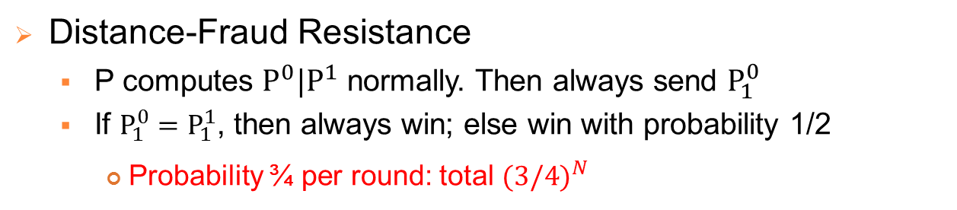
Security: Distance-Fraud Resistance
P
V
P
$$R_{V}$$
$$R_{P}$$
V
$$P^{0}|P^{1}←{PRF}_{K}\left(R_{P} \right|{ R}_{V})$$
$chg ←PRG(seed)$
$${chg}_{i}$$
$$P_{i}^{{chg}_{i}}$$
Distance-Fraud Resistance
  P computes $P^{0}|P^{1}$ normally. Then always send $P_{1}^{0}$
  If $P_{1}^{0}=P_{1}^{1}$, then always win; else win with probability 1/2
    Probability ¾ per round: total ${(3/4)}^{N}$

Slide 41
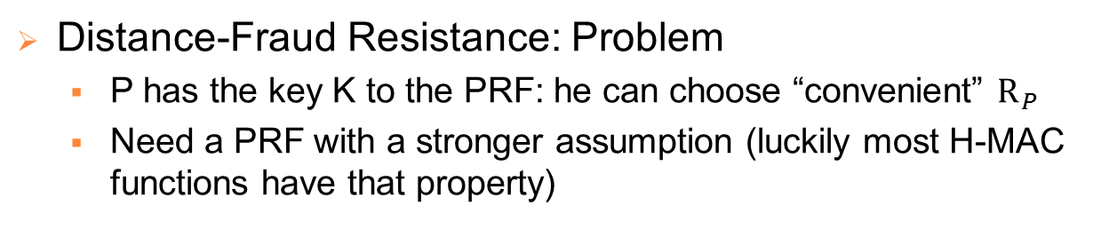
Security: Distance-Fraud Resistance
P
V
P
$$R_{V}$$
$$R_{P}$$
V
$$P^{0}|P^{1}←{PRF}_{K}\left(R_{P} \right|{ R}_{V})$$
$chg ←PRG(seed)$
$${chg}_{i}$$
$$P_{i}^{{chg}_{i}}$$
Distance-Fraud Resistance: Problem
  P has the key K to the PRF: he can choose “convenient” $R_{P}$
  Need a PRF with a stronger assumption (luckily most H-MAC functions have that property)

Slide 42
Part 3
Implementing Distance Bounding

Slide 43
DB protocols in Practice
Do they do distance bounding?
  KorriGo/NaviGo
  Dutch OV card
NO
NO
NO
  Passports/ID cards
  Employee badge
  Contactless payment cards
  KeeLoq
  PKES
NO
NO
NO
NO
Why not???

Slide 44
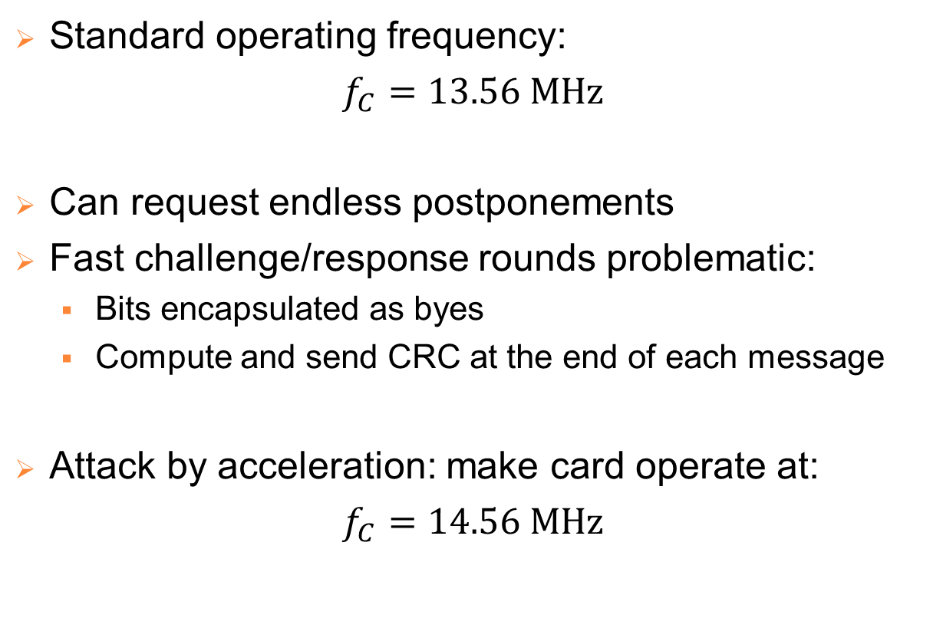
The ISO 14443 standard
Standard operating frequency:
$$f_{C}=13.56 MHz$$
Can request endless postponements
Fast challenge/response rounds problematic:
  Bits encapsulated as byes
  Compute and send CRC at the end of each message
Attack by acceleration: make card operate at:
$$f_{C}=14.56 MHz$$

Slide 45
Industrial Implementations
Mifare Plus card:
  Distance bounding is an option at authentication
  Proprietary protocol and implementation
    Protocol looks nothing like those in the literature
    Not fully ISO 14443 compliant either
    Implementation is very consistent (near-constant times), but subject to acceleration attacks
3DB Technologies:
  Announced distance-bounding countermeasures
  Owners are crypto specialists who also implemented fast exchanges over analogue link (bypassing ISO 14443)

Slide 46
What about Mobile Phones?
P
V
$$K$$
$$K$$
$$seed$$
chg
Start clock
rsp
Stop clock
Store: $∆T$
$$T_{MAX}$$
Ideally:
  Transmission time of chg +
  Transmission time of rsp
  Total: 2 x transmission times = 2 x time separating Alice/Bob

Slide 47
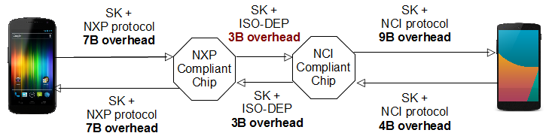
The Mobile Phone Reality
Phones have NFC chips, which do the computations
But:
  Smartphones have many applications running at the same time
  NFC chip data is processed at application layer
  Some layers can be by-passed, but only by rooting the phone

Slide 48
Some Recent Tests Show…
Mobile phone case: not hopeless either
  Variations are important, but below a few ms
  Can detect off-the-shelf attacks (not home-made)
  The lower the protocol is implemented, the better
  Relay attackers also get some of the same delays (prover side)
Relay attacks (finally) acknowledged by industry
  Hopefully we will have solutions soon!

