Slide 1
Elliptic Curve Cryptography
Curves, Pairings, Cryptography

Slide 2
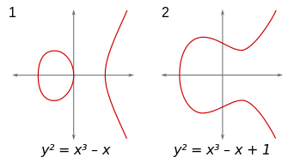
Elliptic Curves
Basic elliptic cuves:
Weierstrass equation:
$y^{2}= x^{3}+Ax+B$ , with $4A^{3}+27 B^{2} ≠0$
The values $A,B, x, y$ come from some set, usually a field

Slide 3
Part 1 Sets, Groups, Rings, Fields

Slide 4
Sets and Groups
Set = “ensemble”
Simply a collection of elements
Group = “groupe”
A set G and an operation “$∙$” (not necessarily multiplication)
Closure: if $a,b ∈$ G, then $a∙b∈$ G
Identity element: there exists an element 1 such that:
1 $∙a=a ∙$ 1 $=a$
Associativity: for any $a,b,c ∈$ G it holds that:
$\left(a ∙b\right)∙c=a ∙(b ∙c)$
Inverse element: for any $a ∈$ G, there exists $b∈$ G such that:
$a ∙b =b ∙a=$ 1

Slide 5
Examples
Is N $=\{0, 1,2,…\}$ a group under addition ($+$)?
Closure: yes, $a+b ∈$ N
Associativity: yes, $\left(a+b\right)+c=\left(a+b\right)+c$
Identity element: yes, $0$: $0+a=a+0=a$
Inverse element: no (no negative integers)
So Z $=\left\{…−2, −1, 0, 1, 2, 3, …\right\}$ is a group under addition
Is Z a group under multiplication?
Is Q $=\{ \frac{a}{b} ;a,b ∈Z\}$ a group under multiplication?
Closure, associativity: yes; identity element: $\frac{1}{1}$
Inverse: what is the inverse of 0 ?
So Q $\backslash$ {0} is a group under multiplication

Slide 6
A group we like to use
Set of integers modulo prime $p$
$$Z_{p}=\{0, 1, 2, …, p−1\}$$
Take a single element $g$, look at the set:
{$g^{0}, g^{1}, g^{2}, …, g^{q−1}, g^{q}=1$ $mod p$}
Under $∙$ = multiplication mod p:
Closure: $g^{a} g^{b}= g^{a+b}=g^{\left(a+b\right) mod q} (mod p)$
Associativity: ${(g}^{a}g^{b})g^{c}= g^{a+b+c}=g^{a}\left(g^{b}g^{c}\right)$
Identity element: $1= g^{0}$
Inverse element: inverse of $g^{a}$ is $g^{(q−a)}$
We usually want $q$ to be prime

Slide 7
Rings
Ring = “anneau”
Set $R$ with operations $+$ and $∙$ such that:
$R$ is a group under + (call id. element $0_{R}$)
+ is commutative:
$$a+b=b+a$$
$∙$is associative and has id. element $1_{R}$
$∙$is distributive w.r.t. +
$$a ∙\left(b+c\right)=\left(a∙b\right)+\left(a ∙c\right)$$
$$\left(b+c\right)∙a=\left(b∙a\right)+(c ∙a)$$

Slide 8
Rings
Characteristic of $R$:
If the id. element of $∙$ is $1_{R}$ and the id. element of + is $0_{R}$, if there exists a number $N∈$ N such that:
$1_{R}+ 1_{R}+ …+ 1_{R}= 0_{R}$
Then $N$ is characteristic of $R$
If $N$ does not exist, then $R$ has characteristic 0
$N$ times
Set of integers Z is not a group under multiplication:
Closure: yes
Id. element: yes, 1
Associativity: yes
Inverse element: no
However, Z is a ring (char. 0) under addition and multiplication

Slide 9
Sets, Rings, Fields
(Finite) Field = “corps (finit)”
Set $K$ (of finite size) with operations $+$ and $∙$ such that:
$K$ is group under + and $∙$ (id. elements $0_{K}, 1_{K}$ respectively)
No inverse required for $0_{K}$
+ and $∙$ are commutative:
$$a+b=b+a; a∙b=b∙a$$
$∙$is distributive w.r.t. +:
$$a ∙\left(b+c\right)=\left(a∙b\right)+\left(a ∙c\right)$$
$$\left(b+c\right)∙a=\left(b∙a\right)+\left(c ∙a\right)$$
The operations + and $∙$ are called “addition”/ “multipli-cation”, but you can define them in any way you want

Slide 10
Some Fields
The real numbers R are an infinite field under + and $∙$
Define now:
$$a∙b ≔\sqrt[b]{a}= a^{1/b}$$
Is R still a field?
No, since $\left(−1\right)∙2= \sqrt{−1}$, which is a complex number
OK, change it to:
$$a ∙b= \sqrt[b]{\left|a\right|}= {|a|}^{1/b}$$
Is R a field now?
No, multiplication is not commutative: $a∙b={|a|}^{1/b}$ while $b∙a={|b|}^{1/a}$

Slide 11
Some fields we like to use
The field $F_{p}=\{0, 1, …, p−1\}$ under + and $∙$ mod p
We need the 0, otherwise it’s not a field under +
Characteristic: p
Sometimes we use $∙$ as “scalar multiplication” rather than just multiplication of 2 elements
The field $F_{q}$ with $q= p^{k}$ , for $k≥1$
Usually we like to use $2^{k}$ which is of characteristic 2
This field has elements which are polynomials with coefficients in $F_{p}$
We choose an irreducible polynomial of degree k
Elements of $F_{q}$ are all polynomials of smaller degree

Slide 12
Part 2 Back to Elliptic Curves

Slide 13
Elliptic Curves
Basic elliptic cuves on field $K$:
Weierstrass equation: $y^{2}= x^{3}+Ax+B$, $A, B, x, y ∈K$
Only for curves of characteristic $≠2,3$
Generalized Weierstrass form:
$$y^{2}+b_{1} xy+ b_{2}y= x^{3}+ a_{2}x^{2}+ a_{1}x+ a_{0}$$
Points of the curve: $P= \left(x,y\right)$ with $x,y ∈K$ and a point $∞$
Point at infinity $∞$ is where parallel lines meet

Slide 14
Group Structures
Crypto in Finite Fields
Usual case: we take $F_{p}$ for a prime $p$
We need (for crypto) a group G = <$g^{0}, g^{1},…, g^{q−1}$> for a prime q and $g∈F_{p}$
Can we take $F_{p}$?
It’s a field, so a group under addition and multiplication
With a small problem though: the 0 element not invertible!
What we want is $F_{p}^{∗}= F_{p} \backslash$ $\{0\}$
But $F_{p}^{∗}$ has order $\left(p−1\right)$, which is even, thus not prime!
We usually find a prime $q | (p−1)$ and a generator $g$ for this group, ensuring that all elements are invertible!
How do we get this for elliptic curves?

Slide 15
Recall: Groups
Group = “groupe”
A set G and an operation “$∙$” (not necessarily multiplication)
Closure: if $a,b ∈$ G, then $a∙b∈$ G
Identity element: there exists an element 1 such that:
1 $∙a=a ∙$ 1 $=a$
Associativity: for any $a,b,c ∈$ G it holds that:
$\left(a ∙b\right)∙c=a ∙(b ∙c)$
Inverse element: for any $a ∈$ G, there exists $b∈$ G such that:
$a ∙b =b ∙a=$ 1
Q: What is my operation on ECs?

Slide 16
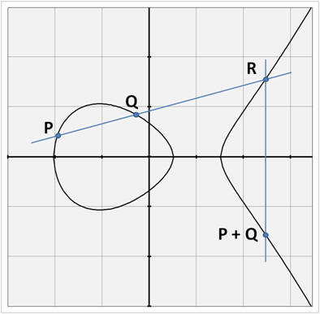
Point Addition
Finite fields modulo p:
Multiplicative, i.e. operation is multiplication (mod p)
Elliptic curves on K ($E(K)$):
Additive: operation is point addition
Adding points $P,Q ∈E(K)$ :
Draw line through P,Q
Find 3rd intersection point R
Draw vertical at R
Take the opposite of R
E constructed with 3 points of intersection (sometimes multiple, sometimes also $∞$ is one of the points)

Slide 17
Case 1: 3 different intersections
Adding points $P≠Q ≠(−P) ∈E(K)$ :
Draw line through P,Q
Line equation: $y=mx+c$
Slope: $m= \frac{y_{Q}−y_{P}}{x_{Q}−x_{P}}$
Substitute: $y_{Q}=m x_{Q}+c$
$c=y_{Q}−m{ x}_{Q}$
Line equation: $y=mx+\left(y_{Q} −mx_{Q}\right)$
$y=m \left(x − x_{Q}\right)+ y_{Q}$
Find 3rd intersection point R
Draw vertical at R
Take the opposite of R

Slide 18
Case 1: 3 different intersections
Adding points $P≠Q ≠(−P) ∈E(K)$ :
Draw line through P,Q
$$y=m \left(x − x_{Q}\right)+ y_{Q}$$
Find 3rd intersection point R
Weierstrass: $y^{2}= x^{3}+Ax+B$
Replace: ${(m \left(x − x_{Q}\right)+ y_{Q})}^{2}= x^{3}+Ax+B$
Work magic: $x_{R}= m^{2}− x_{P}− x_{Q}$
$y_{R}=m\left(x_{R} − x_{P}\right)+ y_{P}$
Draw vertical at R
Take the opposite of R

Slide 19
Case 1: 3 different intersections
Adding points $P≠Q ≠(−P) ∈E(K)$ :
Draw line through P,Q:
$$y=m \left(x − x_{Q}\right)+ y_{Q}$$
Find 3rd intersection point R
$$x_{R}= m^{2}− x_{P}− x_{Q}$$
$y_{R}=m\left(x_{R} − x_{P}\right)+ y_{P}$
Draw vertical at R
Line equation: $x=x_{R}$
Take the opposite of R

Slide 20
Case 1: 3 different intersections
Adding points $P≠Q ≠(−P) ∈E(K)$ :
Draw line through P,Q:
$$y=m \left(x − x_{Q}\right)+ y_{Q}$$
Find 3rd intersection point R
$$x_{R}= m^{2}− x_{P}− x_{Q}$$
$y_{R}=m\left(x_{R} − x_{P}\right)+ y_{P}$
Draw vertical at R
$$x=x_{R}$$
Take the opposite of R
$$x_{P+Q}= m^{2}− x_{P}− x_{Q}$$
$y_{P+Q}=m\left(x_{P} − x_{P+Q}\right)− y_{P}$

Slide 21
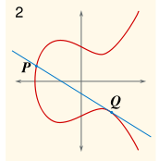
Case 2: Add point with tangent point
Still $P≠Q ≠(−P) ∈E(K)$ :
Draw line through P,Q
Find 3rd intersection point R
Calculations will give you:
$$R=Q$$
Draw vertical at R
Take the opposite of R:
$$x_{P+Q}=x_{Q}$$
$$y_{P+Q}=−x_{Q}$$

Slide 22
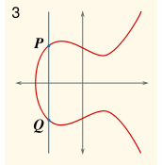
Case 3: Add points with same x-coord.
Add $P=(−Q) ∈E(K)$ :
Draw line through P,Q
Find 3rd intersection point R
Third point is $∞$, the point at infinity
Draw vertical at R
Take the opposite of R:
We write: $P+Q=−∞= ∞$

Slide 23
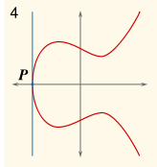
Case 4: Point Doubling
Now $P=Q ∈E(K)$ :
Draw tangent line through P
Find 3rd intersection point R
If $y_{P}=0,$ then $R=∞$, the point at infinity
Else: $m=\frac{3x_{P}^{2}+A}{2y_{P}}$
$$x_{R}= m^{2}−2x_{P}$$
$y_{R}=m\left(x_{R} − x_{P}\right)+ y_{P}$
Draw vertical at R
Take the opposite of R:

Slide 24
Case 4: Point Doubling
Now $P=Q ∈E(K)$ :
Draw tangent line through P
Find 3rd intersection point R
$$x_{R}= m^{2}−2x_{P}$$
$y_{R}=m\left(x_{R} − x_{P}\right)+ y_{P}$
Draw vertical at R
Take the opposite of R:
If $y_{P}=0,$ then $P+Q=∞$
Else:
$$x_{P+Q}= m^{2}−2x_{P}$$
$y_{P+Q}=m\left(x_{P} − x_{R}\right)− y_{P}$

Slide 25
Groups on Elliptic Curves
Take an elliptic curve $E\left(K\right)$
Operation: point addition
Scalar multiplication: repeated addition:
$$kP=P+P+ …. + P$$
Order of a point: smallest integer such that:
$$kP= ∞$$
Take set G = <$P, 2P, …, kP=∞$> and point addition
Closure: if $Q,R ∈$ G, then $Q+R∈$ G
Identity element: the point at infinity, $∞$
Associativity: associative and commutative
Inverse element: Define $−P$ as ($x_{P}, −y_{P}$): opposite the $x$-axis
$k$ times

Slide 26
Part 3 Basic Elliptic Curve Crypto

Slide 27
Hard Problems in ECC
DLog settings in finite fields $F_{p}$
Find prime $q|\left(p−1\right).$
Choose element $g$ of order $q$, consider G = <$g^{0}, …, g^{q−1}$>
Choose $a∈_{R}\{0, …, q−1\}$, set $A≔g^{a} (mod p)$
DLog problem: given ($g, p, q, A$) find $a$.
ECDLog settings on $E(F_{p})$ or $E(F_{p^{k}})$
Find prime $q | \#E(F_{p})$
Choose an element $P$ of order $q$, consider G = <$P,…, qP$>
Choose $a ∈_{R} \{0, 1, …, q−1\}$, set $A ≔aP$
ECDLog problem: given ($p, k,q, E, A$), find $a$.

Slide 28
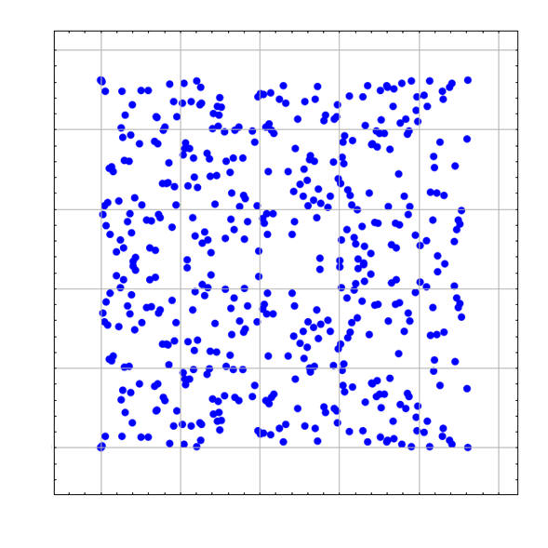
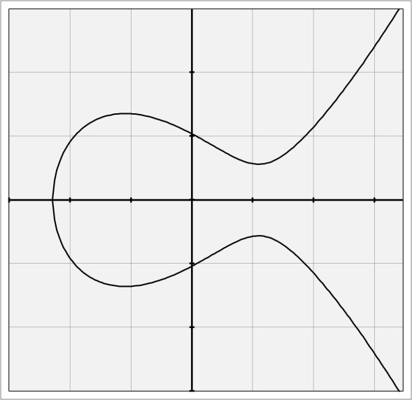
Hint: Why the Problem is Hard
Elliptic curve over R
Elliptic curve over $F_{p}$

Slide 29
Hard Problems in ECC
CDH on finite fields $F_{p}$
Find prime $q|\left(p−1\right).$
Choose element $g$ of order $q$, consider G = <$g^{0}, …, g^{q−1}$>
Choose $a,b∈_{R}\{0, …, q−1\}$, set
$A≔g^{a} \left(mod p\right), B= g^{b} (mod p)$
CDH problem: given ($g, p, q, A,B$) find $g^{ab} (mod p)$.
ECCDH settings on $E(F_{p})$ or $E(F_{p^{k}})$
Find prime $q | \#E(F_{p})$
Choose an element $P$ of order $q$, consider G = <$P,…, qP$>
Choose $a,b ∈_{R} \{0, 1, …, q−1\}$, set $A ≔aP$ and $B ≔bP$
ECDLog problem: given ($p, k,q, E, A,B$), find $abP$.

Slide 30
Hard Problems in ECC
DDH on finite fields $F_{p}$
Find prime $q|\left(p−1\right).$
Choose element $g$ of order $q$, consider G = <$g^{0}, …, g^{q−1}$>
Choose $a,b,z∈_{R}\{0, …, q−1\}$, set
$A≔g^{a} \left(mod p\right), B= g^{b} (mod p)$
DDH problem: given ($g, p, q, A,B$) dist. $g^{ab}$from $g^{z} (mod p)$.
ECDDH settings on $E(F_{p})$ or $E(F_{p^{k}})$
Find prime $q | \#E(F_{p})$
Choose an element $P$ of order $q$, consider G = <$P,…, qP$>
Choose $a,b,z ∈_{R} \{0, 1, …, q−1\}$, set $A ≔aP$ and $B ≔bP$
ECDLog problem: given ($p, k,q, E, A,B$), dist. $abP$ from $zP$.

Slide 31
Hardness of ECDlog/ECCDH/ECDDH
Algorithms to break ECDLog O($\sqrt{q}$) :
Baby Step Giant Step
Pollard-Rho
Some progress on Index-Calculus attacks recently
Hardness depends on “size” of subgroup and curve
Usually want $\#E\left(K\right)=f q$ with $f∈\left\{1,2,4\right\}$ (for speed)
Use list of NIST recommended curves … or not
Do not use $E(F_{p^{m}})$ for $m>2$ non-prime (attacks!)
Choose $q$ s.t. it does not divide $p^{B}−1$ for small $B$ (attacks!)
Do not use $E(K)$ of size |$K$|
Computing $\#E(K)$ : Schoof // Schoof-Elkies-Atkin alg.

Slide 32
Part 3.1 EC Key Exchange

Slide 33
Diffie-Hellman: finite fields and ECs
Alice
Bob
Alice
Bob
Choose
$$a∈_{R}\{0, …, q−1\}$$
Choose
$$b∈_{R}\{0, …, q−1\}$$
Choose
$$a∈_{R}\{0, …, q−1\}$$
Choose
$$b∈_{R}\{0, …, q−1\}$$
$$A=aP$$
$${A= g}^{a} (mod p)$$
$$B=bP$$
$$B= g^{b} (mod p)$$
Compute
$$K= A^{b} (mod p)$$
Compute
$$K=bA$$
Compute
$$K=aB$$
Compute
$$K= B^{a} (mod p)$$
Same $K$:
$$A^{b}= {(g^{a})}^{b}= g^{ab}={(g^{b})}^{a}=B^{a}$$
Same $K$:
$$bA=baP=abP=aB$$

Slide 34
Security of Diffie-Hellman
Alice
Bob
Alice
Bob
Choose
$$a∈_{R}\{0, …, q−1\}$$
Choose
$$b∈_{R}\{0, …, q−1\}$$
Choose
$$a∈_{R}\{0, …, q−1\}$$
Choose
$$b∈_{R}\{0, …, q−1\}$$
$$A=aP$$
$${A= g}^{a} (mod p)$$
$$B=bP$$
$$B= g^{b} (mod p)$$
Compute
$$K= A^{b} (mod p)$$
Compute
$$K=bA$$
Compute
$$K=aB$$
Compute
$$K= B^{a} (mod p)$$
$K$ indistinguishable from random iff.
DDH is hard in G
$K$ indistinguishable from random iff.
ECDDH is hard in G

Slide 35
Part 3.2 EC Digital Signatures

Slide 36
Digital Signatures (EC) DSA
Setup
Setup
Choose prime $q$
Choose $E(F_{p})$ or $E\left(F_{p^{n}}\right)$ with
$\#E\left(K\right)=hq$ and $h∈\{1,2,4\}$
Choose prime $p$ such that: $q| p−1$
Pick $y<p$ with: ${ y}^{(p−1)/q}≠1 \left(mod p\right)$
Let ${ g=y}^{(p−1)/q}$
Pick element $P$ of order $q$
Publish: $p,\left(n\right), q,h, E, P$
Publish: $p,q,g$
Key Generation
Key Generation
Choose: $sk∈_{R}\{0, …, q−1\}$
Choose: $sk∈_{R}\{0, …, q−1\}$
Set: $pk= g^{sk} (mod p)$
Set: $PK=sk P$
Publish: $pk$
Publish: $PK$

Slide 37
Digital Signatures (EC) DSA
Signing
Signing
Message $m$, hashed to $h=H(m)$
Message $m$, hashed to $h=H(m)$
Choose ephemeral $k∈_{R}\{1, …, q−1\}$
Choose ephemeral $k∈_{R}\{1, …, q−1\}$
Compute: $r=\left(g^{k} mod p\right) mod q$ and
$s={(h+sk∗r)}/k mod q$
Compute: $R=kP=(x_{R},y_{R})$ and
$s={(h+sk∗x_{R})}/k mod q$
Output: $m, σ=(r,s)$
Output: $m, σ=(R,s)$
Verification
Verification
Hash message to $h=H(m)$
Hash message to $h=H(m)$
Compute $a= h/s mod q$ and $b=r/s mod q$
Compute $a= h/s mod q$ and $b={x_{R}}/s mod q$
Output $1$ iff.:
$$r = {(g}^{a} {pk}^{b} (mod p)) (mod q)$$
Output $1$ iff.:
$$R =a P+b PK$$

Slide 38
Part 3.3 EC Encryption Schemes

Slide 39
Integrated Encryption Scheme (IES)
Designed by Abdalla, Bellare, and Rogaway
Elliptic curve version proposed by Shoup
Relies on hardness of (EC)DDH
Ingredients:
A secure Key Derivation Function (KDF)
This used to be a hash function
If replaced by hash, we need stronger assumptions: either that the hash function is a random oracle, or we need a different hard problem
A secure (IND-CPA) symmetric encryption function
A secure (EU-CMA) MAC scheme

Slide 40
Public-Key Encryption (EC) IES
Setup
Setup
Choose prime $q$
Choose $E(F_{p})$ or $E\left(F_{p^{n}}\right)$ with
$\#E\left(K\right)=hq$ and $h∈\{1,2,4\}$
Choose prime $p$ such that: $q| p−1$
Pick $y<p$ with: ${ y}^{(p−1)/q}≠1 \left(mod p\right)$
Let ${ g=y}^{(p−1)/q}$
Pick element $P$ of order $q$
Publish: $p,\left(n\right), q,h, E, P$
Publish: $p,q,g$
Key Generation
Key Generation
Choose: $sk∈_{R}\{0, …, q−1\}$
Choose: $sk∈_{R}\{0, …, q−1\}$
Set: $pk= g^{sk} (mod p)$
Set: $PK=sk P$
Publish: $pk$
Publish: $PK$

Slide 41
Public-Key Encryption (EC) IES
Enc
Enc
Choose ephemeral $k∈_{R}\{1, …, q−1\}$
Choose ephemeral $k∈_{R}\{1, …, q−1\}$
Compute: $K_{1}|K_{2}=KDF[{pk}^{k} (mod p)]$
Compute: $K_{1}|K_{2}=KDF[k PK]$
Encrypt $m$to$c={SEnc}_{K_{1}}(m)$
Encrypt $m$to$c={SEnc}_{K_{1}}(m)$
MAC $c$to$tag={MAC}_{K_{2}}(c)$
MAC $c$to$tag={MAC}_{K_{2}}(c)$
Output: $(g^{k}, c, tag)$
Output: $(kP, c, tag)$
Dec
Dec
Do: $K_{1}|K_{2}=KDF[{(g^{k})}^{sk}(mod p)]$
Do: $K_{1}|K_{2}=KDF[sk ∙kP]$
Verify $tag=={MAC}_{K_{2}}(c)$
Verify $tag=={MAC}_{K_{2}}(c)$
If OK then do: $m={SDec}_{K_{1}}(c)$
If OK then do: $m={SDec}_{K_{1}}(c)$

Slide 42
Part 3.4 From Theory to Practice

Slide 43
Fast curves, Fast Implementations…
Implementations not always as good as theory:
Playstation 3 implemented ECDSA … with constant $k$
Some curves have been compromised
Things to keep in mind:
Select secure curves
Use appropriate libraries:
Java: FlexiProvider, Bouncy Castle
C++ & cp: Crypto++, NaCl (“salt”)
Python: NaCl
Implementers need to know tricks, e.g. Jacobian coord.
Constant-time implementations prevent SCA: one solution is using Edwards curves!

Slide 44
Part 4 Pairings

Slide 45
Abstract Pairings
Setting :
2 additive groups $G_{1}, G_{2}$, multiplicative group $G_{T}$
All three groups of prime order $q$
We can write $G_{1}=<P, …qP>$ and $G_{2}=<Q, …, qQ>$
Imagine a mapping $e: G_{1} × G_{2} →G_{T}$ such that:
Bilinear: for all $a,b∈\{1, …, q−1\}$ it holds that:
$$e\left(aP, bQ\right)= {e(P,Q)}^{ab}$$
Non-degenerate: $e(P,Q)≠1$
Efficiently computable

Slide 46
Pairings on Elliptic Curves
We begin with our favourite finite field $F_{p}$ or $F_{p^{n}}$
Take elliptic curve $E$ on that field (or an extension field)
Look first at $G_{T}$:
We take values $x$ such that $x^{q}=1$ (in our field)
We make sure there are $q$ of them
Pairings depend on the embedding degree of a curve:
The higher the embedding degree the better security is in $G_{T}$
Smallest integer $k$ such that $q | p^{k}−1$
The bigger $k$ is, the harder it is to compute pairing
$G_{T}$ taken over a subgroup in $E\left(F^{k}\right)$
Usually: k = 2, 3, 4, 6, 12

Slide 47
Choosing $G_{1}, G_{2}$
Standard:
$G_{1}$ is just a typical additive cyclic group of order $q$ as before
Tempting: just choose $G_{2}= G_{1}$
For Tate/Weil pairings, that means $e\left(P, Q\right)=1$
Non-degeneracy:
Option 1: choose different, disjoint group $G_{2}$
Barreto/Naehrig do that for k = 12
Option 2: distortion map to change $G_{1}$ into $G_{2}$
Used for k = 2 supersingular curves

Slide 48
Three-Party KE with Pairings
$$a∈_{R}\{0, …, q−1\}$$
$A_{1}=aP$; $A_{2}=aQ$
Alice
Bob
Alice
Choose
$$a∈_{R}\{0, …, q−1\}$$
Choose
$$b∈_{R}\{0, …, q−1\}$$
$$A=aP$$
$$A_{1}, A_{2}$$
$$B=bP$$
$$C_{1}, C_{2}$$
$$B_{1}, B_{2}$$
Charlie
Bob
Compute
$$K=bA$$
Compute
$$K=aB$$
$$c∈_{R}\{0, …, q−1\}$$
$C_{1}=cP$; $C_{2}=cQ$
$$b∈_{R}\{0, …, q−1\}$$
$C_{1}=bP$; $C_{2}=bQ$
Same $K$:
$$bA=baP=abP=aB$$

Slide 49
Three-Party KE with Pairings
$K={e( B_{1}, C_{2} )}^{a}$ =
$${e(bP,cQ)}^{a}= {e(P,Q)}^{abc}$$
Alice
Bob
Alice
Choose
$$a∈_{R}\{0, …, q−1\}$$
Choose
$$b∈_{R}\{0, …, q−1\}$$
$$A_{1}, A_{2}$$
$$A=aP$$
$$B=bP$$
$$C_{1}, C_{2}$$
$$B_{1}, B_{2}$$
Charlie
Bob
Compute
$$K=bA$$
Compute
$$K=aB$$
$$K={e( A_{1}, B_{2} )}^{c}=$$
$${e(aP,bQ)}^{c}=$$
$${e(P,Q)}^{abc}$$
$K={e( C_{1}, A_{2} )}^{b}$=
$${e(P,Q)}^{ab}$$
Same $K$:
$$bA=baP=abP=aB$$

Slide 50
More uses for Pairings
Multi-party key exchange
Identity-based encryption
Anonymity-preserving schemes:
Rings signatures
Group signatures
Signatures of knowledge
…
Proofs of Knowledge:
Witness-indistinguishable PoK
Non-interactive Zero-knowledge PoK
…

